Slide 1

A Mini Project Synopsis on “WEB BASED BLOOD DONATION MANAGEMENT SYSTEM” Submitted In partial fulfilment of the requirement for the V Semester of Bachelor of Technology in Computer Science and Engineering of the academic year 2019-20 Submitted By: SYED AHRAR HUSSAINI R17CS421 SUMEDH V GOWDA R17CS416 SYED HAROON A R17CS422 SYED UMAR R17CS425 Mini Project Group ID: G8 Section: G SEC Under the guidance of: Prof. GOPINATH R Asst. Professor School of C & IT, REVA University

Slide 2
ABSTRACT
Blood donation is required during an organ transplant, accidents, cancer treatment etc. For blood donation, one needs to check for a donation camp or needs to visit blood bank. The Manual Blood donation system has many disadvantages which includes, it is too time consuming, often leads to error prone results, consumes lot of manpower, lacks donor information, retrieval of data takes a lot of time, percentage of accuracy is less. In the time of emergency, it becomes difficult to approach the right donor. Rare blood groups are not available all the time at all blood banks and recipients find difficulties to track the right blood donor.
The waterfall Model is a linear sequential flow. In which progress is seen as flowing steadily downwards (like a waterfall) through the phases of software implementation. This means that any phase in the development process begins only if the previous phase is complete. The waterfall approach does not define the process to go back to the previous phase to handle changes in requirement. The waterfall approach is the earliest approach that was used for software development

Slide 3
INTRODUCTION
This online blood donation management system maintains the list of blood donors and also helps the recipients to track and search the right donor easily. It has two modules namely Admin and User. Admins can add hospitals having blood banks and can also add various blood donation camps. He/she can also view the list of donors of a particular area with proper Blood cross match. He/she can also check for blood requests and in case of emergency he/she can send notifications to blood donors as per the requirements. Users can register and make a request. Users can also register as a donor.
Donors can check for Blood camps and hospitals for blood donation and will be getting notifications in case of emergency. They can either accept or ignore it. This project aims at maintaining all information regarding blood donors, different blood groups available in blood banks as wells as blood camps and help them manage in a better way.

Slide 4
The system comprises of 2 major modules as follows: BLOOD SEEKER 1. SIGN UP 2. SIGN IN 3. SEARCH BLOOD GROUP 4. FIND DONORS 5. CALL DONORS BLOOD DONOR 1. SIGN UP 2. SIGN IN 3. SPECIFY BLOOD TYPE 4. UPDATE PROFILE 5. RECEIVE CALL

Slide 5
MOTIVATION
There is a need of blood donors in the world. We all have heard a lot of stories where people have lost their loved ones just because the blood was just not available at the right time. Just to help the society with the knowledge of blood donation and the knowledge of the donors present around this web app will be helpful.
It might save a life and that's all is needed at the moment.

Slide 6
OBJECTIVES
1. Project Aim is to provide transparency in this field, make the process of obtaining blood from a blood bank hassle-free and corruption-free and make the system of blood bank management effective.
2. This project aims at maintaining all the information pertaining to blood donors, different blood groups available in each blood bank and help them manage in a better way.
3. It can achieve hassle free, fast access to blood seekers all around and a easy away to connect them with the blood donors.

Slide 7
SYSTEM REQUIREMENTS
Hardware Requirements
Processor – Core i3
Hard Disk – 160 GB(server side)
Memory – 1GB RAM
Software Requirements
Windows 7 or higher
Python 3
Django framework 2.2.6
Mysql database 8.0.18

Slide 8
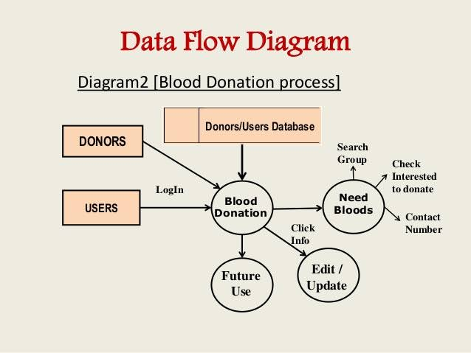
EXPECTED IMPLEMENTATION METHOD

Slide 9
EXPECTED NEW APPLICATIONS
Recipients can get blood easily.
In case of emergency, if the blood group is rare, he/she can find for the certain blood group donor.
Donors can also donate blood easily by checking the list of blood donation camps.

Slide 10
CONCLUSION
This project is needed for the betterment and ease of finding blood donors nearby. It would help various patients, doctors, medical institutes in finding the blood required for various purposes.
Rare blood groups are easily available if their data is stored before hand. And it would help them to donate and acquire blood.
This project is highly beneficial for the society and more importantly it would be a really easy interface to help and serve the society.

Slide 11
REFERENCES
[1] https://suir.tdl.org/shsuir/bitstream/hande/20.500.11875/1164/0781.pdf?sequence=1
[2] https://ieeexplore.ieee.org/document/6208293/
[3] https://ieeexplore.ieee.org/document/4679917/

Slide 12
Thank You

